Slide 1
BIG MART SALES PREDICTION
Submitted by:-20001003505 Chahat Gupta
19001003030 Bhavini Raina
Submitted to :- Dr.Naresh
Mentor:- Dr. Payal Gulati

Slide 2
Introduction
In today’s modern world, huge shopping centers such as big malls and marts are recording data related to sales of items or products with their various dependent or independent factors as an important step to be helpful in prediction of future demands and inventory management. The dataset built with various dependent and independent variables is a composite form of item attributes, data gathered by means of customer, and also data related to inventory management in a data warehouse. The data is thereafter refined in order to get accurate predictions and gather new as well as interesting results that shed a new light on our knowledge with respect to the task’s data. This can then further be used for forecasting future sales by means of employing machine learning algorithms such as the random forests and simple or multiple linear regression
model.

Slide 3
Objective
The aim is to build a predictive model and find out the sales of each product at a particular store. Using this model, BigMart will try to understand the properties of products and stores which play a key role in increasing sales.

Slide 4
Abstract
Machine Learning is a category of algorithms that allows software applications to become more accurate in predicting outcomes without being explicitly programmed. The basic premise of machine learning is to build models and employ algorithms that can receive input data and use statistical analysis to predict an output while updating outputs as new data becomes available. These models can be applied in different areas and trained to match the expectations of management so that accurate steps can be taken to achieve the organization's target. In this paper, the case of Big Mart, a one-stop-shopping-center, has been discussed to predict the sales of different types of items and for understanding the effects of different factors on the items' sales. Taking various aspects of a dataset collected for Big Mart, and the methodology followed for building a predictive model, results with high levels of accuracy are generated, and these observations can be employed to take decisions to improve sales

Slide 5
Machine learning used in this project
A predictive model was developed using Linear regression, Polynomial regression, and Random forest regression techniques for forecasting the sales of a business such as Big-Mart, and it was discovered that the model outperforms existing models.

Slide 6
Data manipulation & cleaning
Data manipulation means to organize or arrange the kind of structured data that is read by computer programs so that it's easier to interpret. Performing this process effectively can improve the quality of your data and analysis, & removing the null values.

Slide 7
EDA in this project.
Exploratory Data Analysis (EDA) is an approach to analyze the data using visual techniques. It is used to discover trends, patterns, or to check assumptions with the help of statistical summary and graphical representations. And we are using pandas profiling , klib library for this exploration.

Slide 8
Library used in ML .
Scikit learn
Linear regression
Label encoding
Standardization.
joblib

Slide 9
Deploy the project in web .
Flask.
Os.
Numpy.
App render.
Joblib.

Slide 10
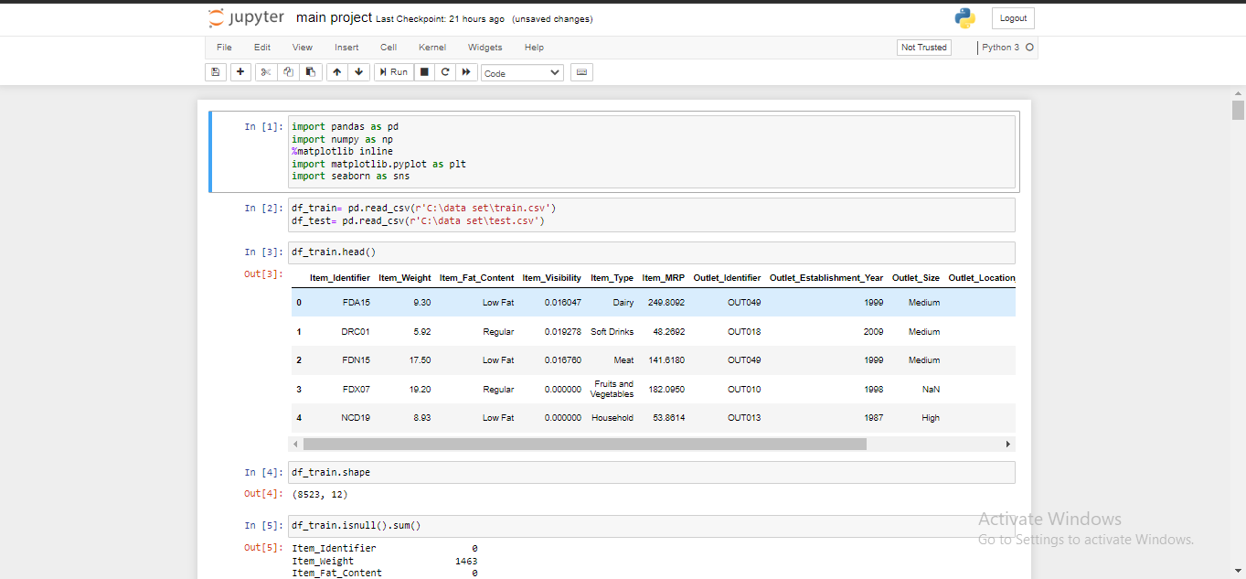
Code of ML part is….
This ML part of project is done is juypter notebook.

Slide 11
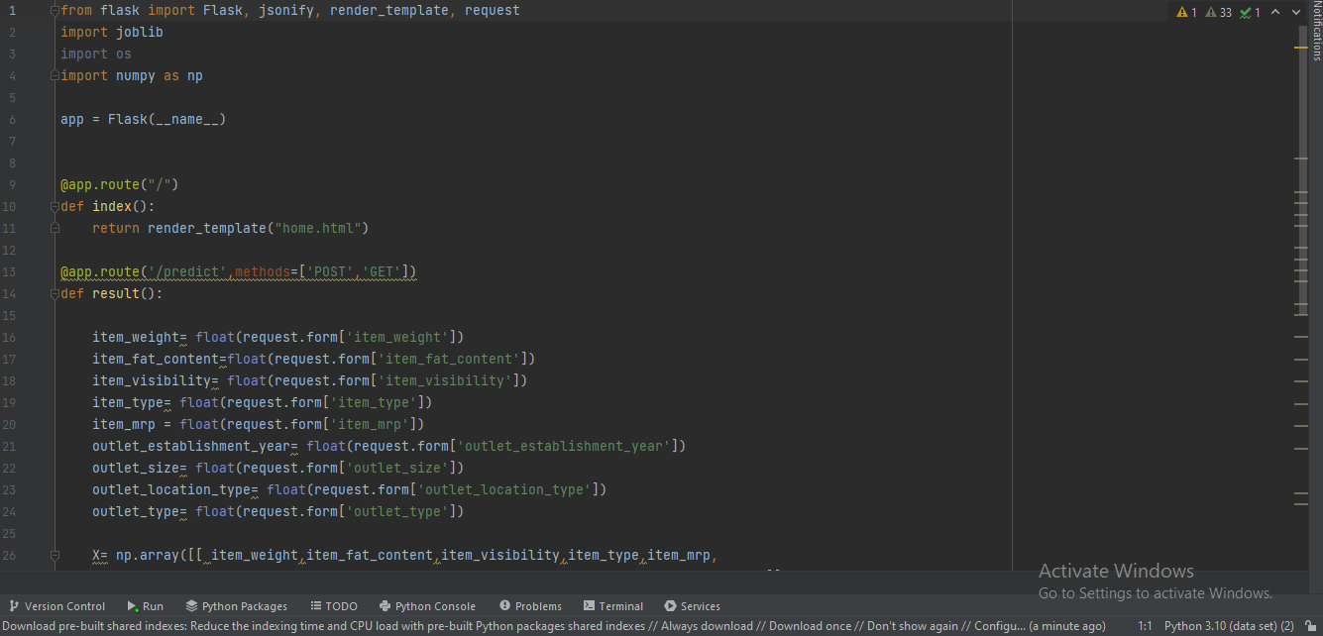
Code of web part is…
This part of part is done in pycharm platform.

Slide 12
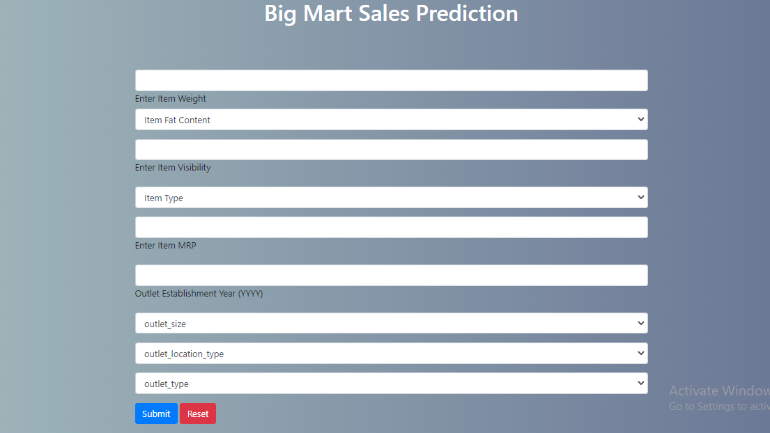
Output on web

Slide 13
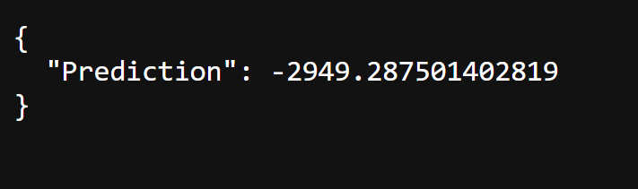
Prediction is..

Slide 14
THANK YOU

